Slide 1
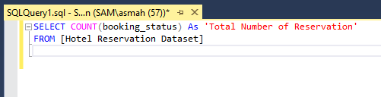
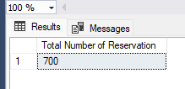
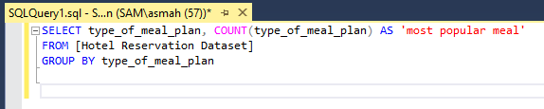
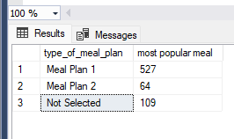
1. What is the total number of reservations in the dataset?
SELECT COUNT(booking_status) As 'Total Number of Reservation' FROM [Hotel Reservation Dataset]
2. Which meal plan is the most popular among guests?
SELECT type_of_meal_plan, COUNT(type_of_meal_plan) As 'most_popular_meal' FROM [Hotel Reservation Dataset]
GROUP BY type_of_meal_plan

Slide 2
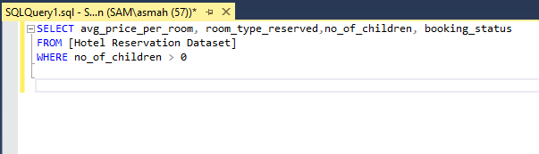
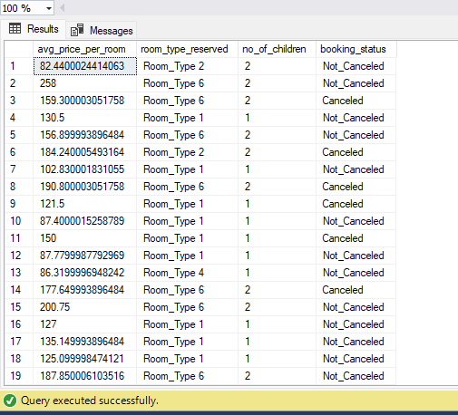
3. What is the average price per room for reservations involving children?
SELECT avg_price_per_room, room_type_reserved,no_of_children, booking_status FROM [Hotel Reservation Dataset]
WHERE no_of_children > 0

Slide 3
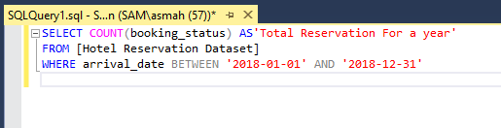
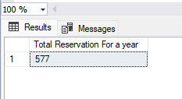

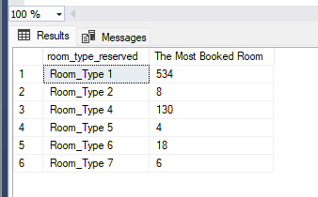
4. How many reservations were made for the year 20XX (replace XX with the desired year)?
SELECT COUNT(booking_status) As 'Total Reservation For a year' FROM [Hotel Reservation Dataset]
WHERE arrival_date BETWEEN '2018-01-01' AND '2018-12-31'
5. What is the most commonly booked room type?
SELECT room_type_reserved, COUNT(room_type_reserved) As 'The Most Booked Room' FROM [Hotel Reservation Dataset]
GROUP BY room_type_reserved

Slide 4




6. How many reservations fall on a weekend (no_of_weekend_nights > 0)?
SELECT COUNT(no_of_weekend_nights) As 'Numbers of Weekend Reservations' FROM [Hotel Reservation Dataset]
WHERE no_of_weekend_nights > 0
7. What is the highest and lowest lead time for reservations?
SELECT MIN(lead_time) As 'The lowest lead time', MAX(lead_time) As 'The highest lead time'
FROM [Hotel Reservation Dataset]

Slide 5

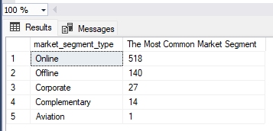


8. What is the most common market segment type for reservations? SELECT market_segment_type, COUNT(market_segment_type) As'The Most Common Segment Type'
FROM [Hotel Reservation Dataset] GROUP BY market_segment_type ORDER BY market_segment_type DESC
9. How Many reservations have a booking status of "Confirmed"?
SELECT COUNT(booking_status) 'Numbers of Confirmed Reservations' FROM [Hotel Reservation Dataset]
WHERE booking_status = 'Not_Canceled'

Slide 6


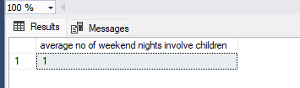
10. What is the total number of adults and children across all reservations?
SELECT SUM(no_of_adults) As 'Total Number of Adults', SUM(no_of_children) As 'Total Number of Children' FROM [Hotel Reservation Dataset]
11. What is the average number of weekend nights for reservations involving children?
SELECT AVG(no_of_weekend_nights) As 'average no of weekend nights involve children' FROM [Hotel Reservation Dataset]
WHERE no_of_children > 0

Slide 7

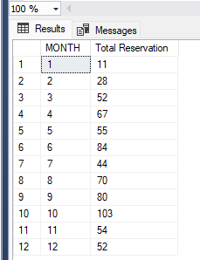
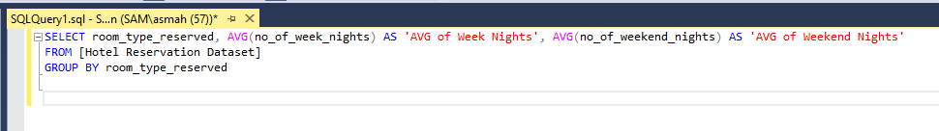
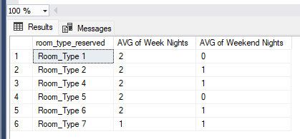
12. How many reservations were made in each month of the year?
SELECT MONTH(arrival_date) As 'MONTH', COUNT(booking_status) As 'Total Reservation' FROM [Hotel Reservation Dataset]
GROUP BY MONTH(arrival_date)
13. What is the average number of nights (both weekend and weekday) spent by guests for each room type?
SELECT room_type_reserved, AVG(no_of_week_nights) As 'AVG of Week Nights', AVG(no_of_weekend_nights) As 'AVG of Weekend Nights'
FROM [Hotel Reservation Dataset] GROUP BY room_type_reserved

Slide 8
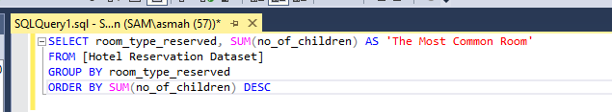
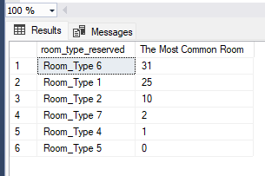
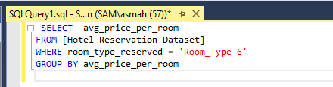
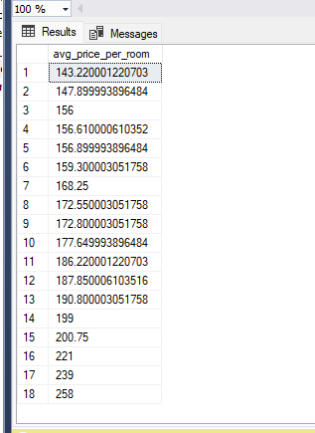
14. For reservations involving children, what is the most common room type, and what is the average price for that room type?
SELECT room_type_reserved, SUM(no_of_children) As 'The Most Common Room' FROM [Hotel Reservation Dataset]
GROUP BY room_type_reserved
ORDER BY SUM(no_of_children) DESC
SELECT avg_price_per_room
FROM [Hotel Reservation Dataset]
WHERE room_type_reserved = 'Room_Type 6' GROUP BY avg_price_per_room

Slide 9

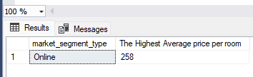
15. Find the market segment type that generates the highest average price per room.
SELECT TOP 1 market_segment_type, MAX(avg_price_per_room) As 'The Highest Average price per room'
FROM [Hotel Reservation Dataset]
GROUP BY market_segment_type
ORDER BY MAX(avg_price_per_room) DESC

